Slide 1
Point Plot — A Simple Way to Compare Averages
What it is • When to use it • How to read it • Python example

Slide 2




What is a Point Plot?
Dots
Line
Average values (mean or median) for each category
Shows how values go up or down across categories
Error Bars
Purpose
Show variation or spread in the data
Useful for comparing categories like Day, Meal, or Gender

Slide 3
Parts of a Point Plot
Dot
Line
Average value (mean/median)
Connects categories → shows trend
Error Bar
Axes
Spread (long = more variation, short = more consistent)
X = categorical (Day, Meal, Gender)Y = numerical (Tip, Bill, Score)

Slide 4

When to Use & How to Read
When to Use
How to Read
1 categorical variable (X-axis)
01
Compare Heights
1 numerical variable (Y-axis)
Which dot is higher? (Higher average)
To compare averages across groups
02
To see trends and variation
Check Direction
Is the line rising or falling? (Trend)
03
Measure Variation
How long are the error bars? (Variation)
Takeaway: Point Plots help compare averages, spot trends, and check variation.

Slide 5
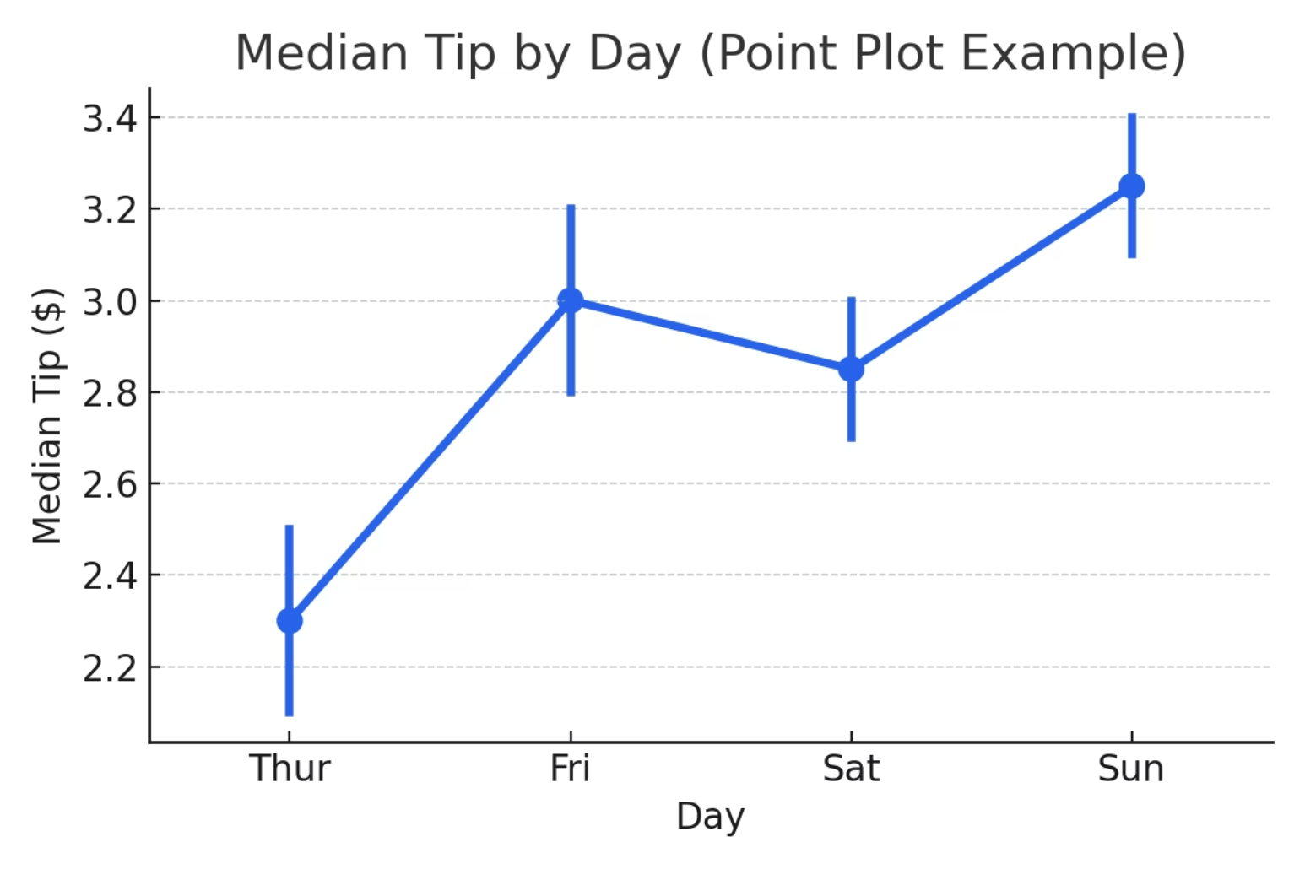
Example (Python + Seaborn)
import seaborn as snsimport matplotlib.pyplot as plttips = sns.load_dataset("tips")sns.pointplot( data=tips, x="day", y="tip", estimator="median", errorbar=("pi", 50), color="#2563EB")plt.title("Median Tip by Day")plt.xlabel("Day")plt.ylabel("Median Tip")plt.show()
Dots
Median tip for each day
Line
Trend Thursday → Sunday
Error Bars
Variation in tips

